Slide 1
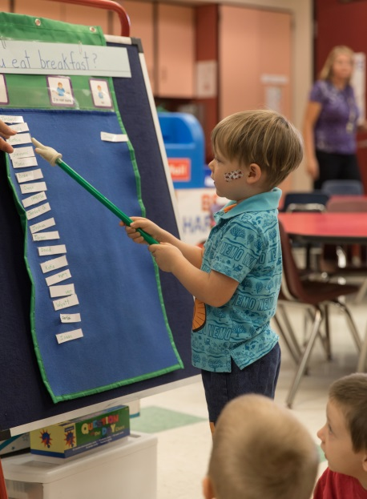
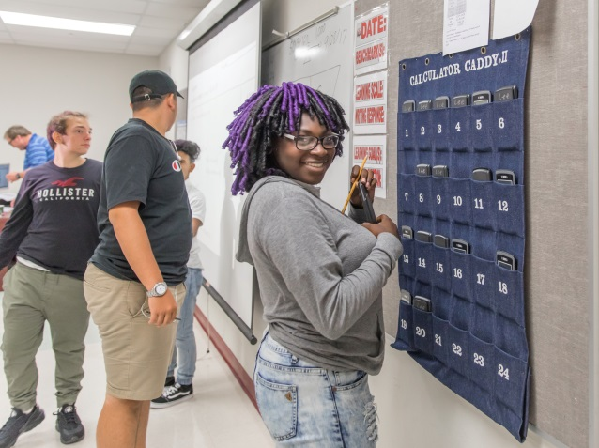
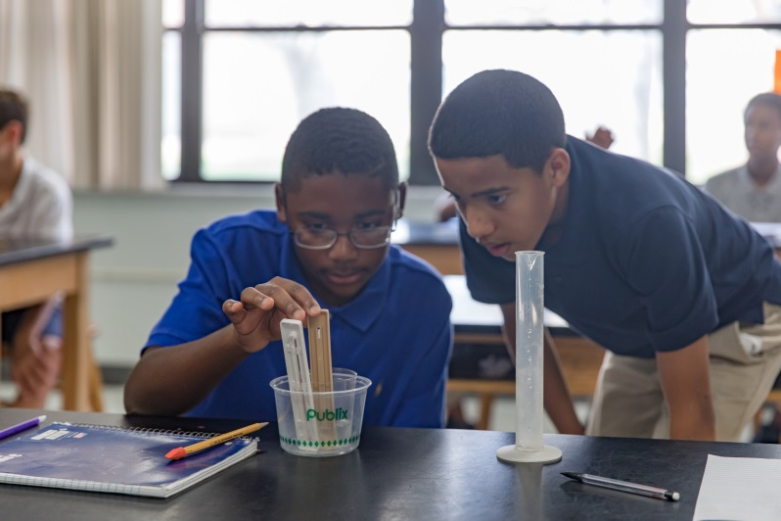
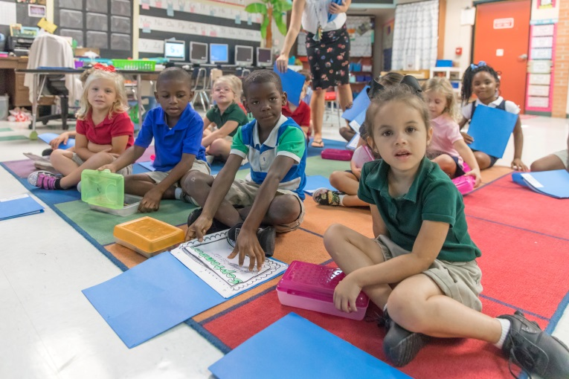
“Letters of Idea” Request for Proposals
Grants up to $10,000
Total of $30,000 to be awarded

Slide 2
Four Focus Areas:
School Culture Climate (social/emotional supports)
Secondary Science (8th – 9th Grade Biology)
Math (6th – 12th)
Reading (K-12th)
Six Month Grant Request to support:
A new project
Expand a proven model
Projects must include measurable outcomes and plans for sustainability.

Slide 3
Funding - $30,000
Dollar-for-Dollar Matching Grant Program
Thank You The Florida Legislature
AND
Grand Harbor Community Outreach
Indian River Golf Club
Quail Valley Charities

Slide 4
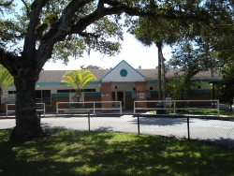
Beachland Elementary
“CARS Coding Application for Reading Support”
Principal: Colleen H. Lord, Ed.D.
$4,675.00

Slide 5
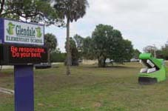
Glendale Elementary
Project Title: “Experiencing Exciting Expeditions”
Principal: Adam Faust $9,499.00

Slide 6
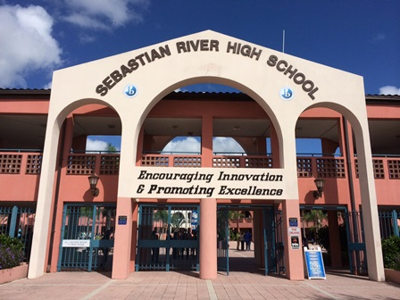
Sebastian River High School
Project Title:
“Competitive Robotics (and more)”
Principal: Todd Racine
Teacher: William Wallace
$4,372.00

Slide 7
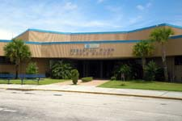
Sebastian River Middle School
Project Title:
“Motivation, Enrichment and Intervention Across the Curriculum”
Principal: Jody Idlette-Brown $7,100.00

Slide 8
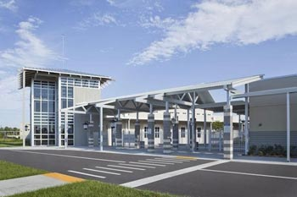
Storm Grove Middle School
Project Title:
“21st Century Seating for 21st Century Learning”
Principal: Ann Bieber $4,650.00

